Slide 1

NOVEL ENERGY CURED MERCAPTO FUNCTIONAL SILICON Q RESIN MATERIALS FOR 3D PRINTING
Bob, Ruckle; Tom-Seung, Cheung; John Grande; & Yanjun Luo
Siltech Corporation
Toronto, ON Canada
Robert@siltech.com, Tom@siltech.com

Slide 2
Problem: Elongation
Silicones routinely provide up to 300% elongation in homopolymers or organic/ silicone hybrid copolymers
UV cured acrylate silicones do not do this elongation is typically under 10%.
The mercapto/vinyl systems bring elongation back to >100% as high as 200% in one.

Slide 3
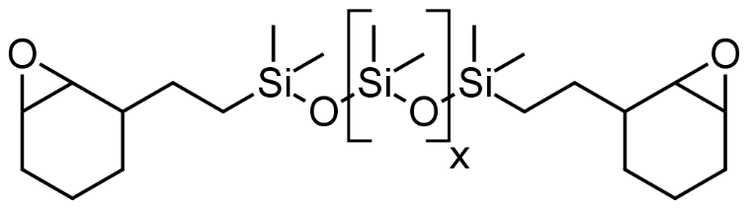
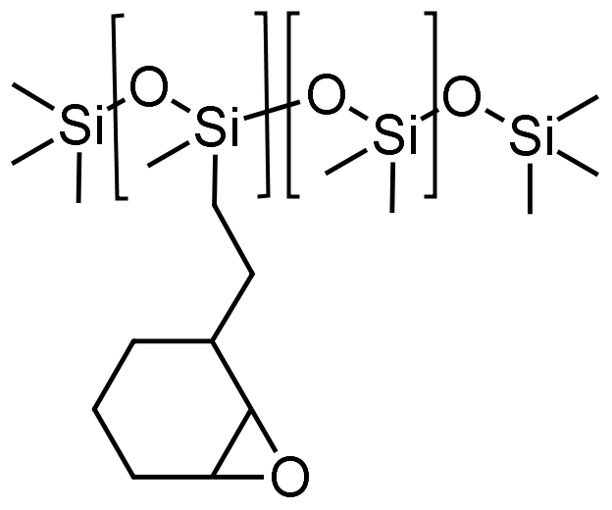
Epoxy Silicone System
Linears
X=400 (20-34%)
X=10 (10-35%)
5-11% MHHPA
AMI-1
110°C, 4 hours
8
250
X-linker (8%)
Notes:
G230-G235 is 2K Heat cure silicone epoxide blend without use of orange epoxy resin.
Project Report 1162 Part VIII

Slide 4
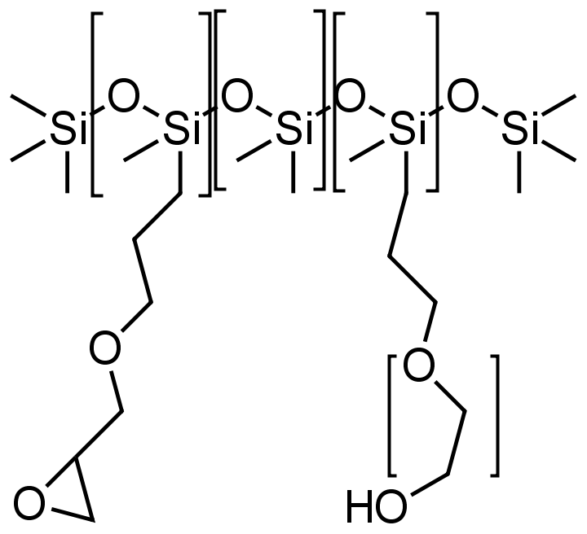
Silicone/ Organic Epoxy Hybrid System
1
8
3
8
0-50%
32-53% D.E.R. 671-X75
17-23% MHHPA
1% AMI-1
0.2% reactive defoamer
110°C, 4 hours
Notes:
Silmer EPC D208

Slide 5
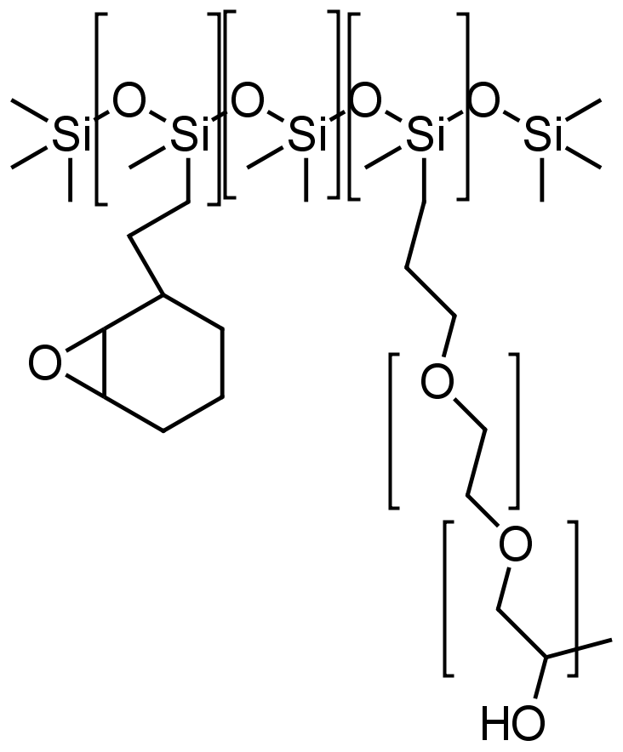
Silicone/ Organic UV Cured Epoxy Hybrid System
1
32
5
18
0-50%
6
50-100 %
UVACURE 1500
UV 9380
UV light, RT

Slide 6
Polymers from
Condensation Reactions
n
R₂ = hydroxyalkyl
silicone
x
n
The flexible silicone is in the backbone elongation is high

Slide 7
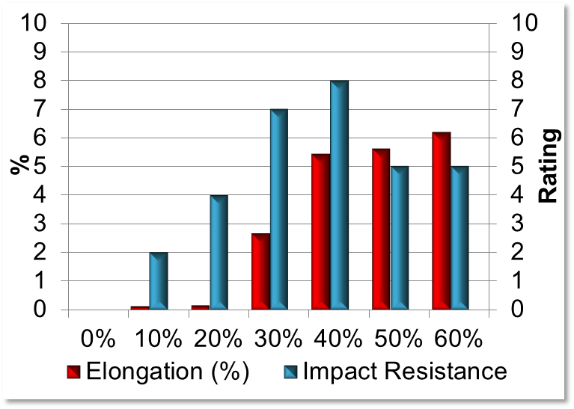
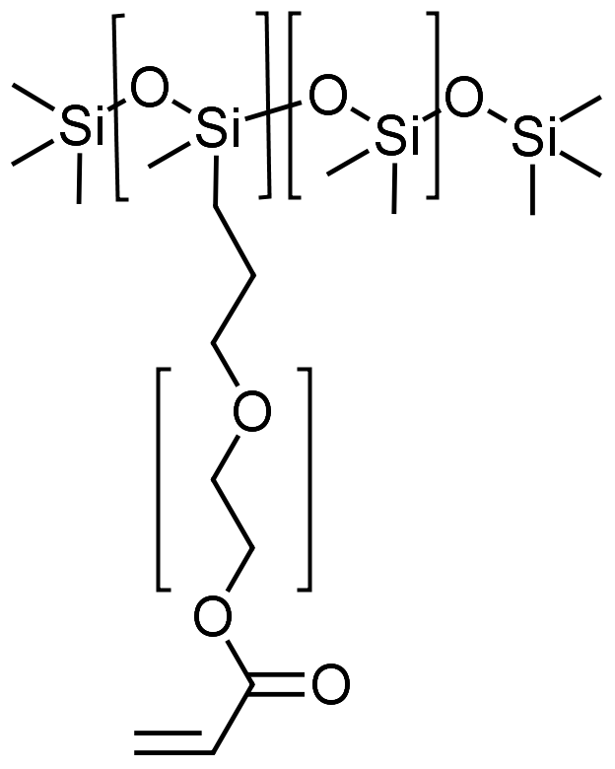
Acrylate Silicone UV coating
0-80% CN 102Z (Epoxy Acrylate)
13% CN 386 (Synergist)
5% Esacure TZT
1.5% Darocur 1173
0.5% reactive defoamer
UV light, RT
0-80% silicone
4
8
8

Slide 8
Free Radical Polymerization
R1=Me, PMA
x
x
R1=Mono Acrylate Silicone
n
The flexible silicone is NOT
in the backbone.

Slide 9
Polymers from Thiol Ene Reaction
R1=organic
x
R1=Silicone
x
x
x
R1=Silicone
R2=MQT Resin
x
The flexible silicone is
in the backbone.
x

Slide 10
Silicon Nomenclature
M group
T group
Trialkoxy silanes are T groups
D group
Q group
MD_{x}M is the standard formula for silicone

Slide 11
Formulation
Ingredient | Amount (wt %) | Purpose
Mercaptosilicon Resin | 5-40% | Cross-linker
65K | 50-70% | Extender
Vinyl Silicon Resin | 15-25% | Softer Cross-Linker
TP0-L | 0.6-0.7% | Photoinitiator

Slide 12
MQT(SH) Silicon Resins
x
y
z
Notes:
Structural details

Slide 13
M(vinyl)QT Silicon Resins
c
a
b
d
Notes:
Structural details

Slide 14
Experimental
These experiments were conducted in a TA Instruments AR-G2 SN 10G4421 Rheometer with a UV reactive chamber.
The rheological properties including G’, G’’, tan (δ) and cure rate are analyzed and obtained by the TA Rheology Advantage software.
The reactions were repeated on the benchtop with a benchtop UV light and cut into shapes for mechanical property measurement on an Instron.

Slide 15
3D Printing
We used an UltiMaker 2+ FMD from Sturctra3D for 3D printing of the SH formulations due to the relatively high viscosity.
This is a thermal cured printer so we attached a UV lamp to the print head to effect UV curing or held the light by hand.

Slide 16
SH/Vinyl Ratio
 | SH 208 | SH 208-10Q | SH 208-20Q | SH 208-30Q | SH 208-40Q | SH 208-50Q
SH/vinyl | 2.33 | 2.46 | 3.05 | 4.44 | 6.75 | 6.85
We determined the optimum SH/Vinyl ratio for each Q/T ratio
x
y
z

Slide 17
Example SH208 (0Q)
Notes:
SH 208 stoichiometry

Slide 18
Amount of Q in MQT(SH)
 | SH 208 | SH 208-10Q | SH 208-20Q | SH 208-30Q | SH 208-40Q | SH 208-50Q
SH/vinyl | 2.33 | 2.46 | 3.05 | 4.44 | 6.75 | 6.85
The higher the Q ratio, the more SH was needed to effect cure.
Above 30% Q, the formulations were unworkable and not testable

Slide 19
Adjusted SiH/Vinyl
 | -10Q | delta | -20Q | delta | -30Q | delta. | -40Q | delta | -50Q | delta
SH/VINYL ratio | 2.46 | 5% | 3.05 | 30% | 4.44 | 90% | 6.75 | 189% | 6.85 | 193%
Tensile Strength (kPa) | 3167 | -3% | 3006 | -8% | Not Measured
Elongation (%) | 85 | 0% | 87 | 9% | Not Measured
Total Energy (J/m) | 171 | -16% | 173 | 4% | Not Measured
Tear Strength (N/mm) | 3.2 | 6% | 1.96 | -45% | Not Measured
Shore A Hardness | 50 | -4% | 49 | -6% | Not Measured
G' (Pa) | 7.11E+05 | 3% | 8.43E+05 | 12% | 7.36E+05 | 69% | 5.18E+05 | 507% | 2.11E+05 | 762%
G" (Pa) | 5.14E+04 | 0% | 5.95E+04 | 10% | 5.97E+04 | 32% | 4.67E+04 | 114% | 6.48E+04 | 546%
tan delta | 0.072 | -3% | 0.071 | -2% | 0.081 | -22% | 0.09 | -65% | 0.308 | -25%
Cure rate (Pa/s) | 1.79E+05 | 42% | 2.47E+05 | 93% | 1.51E+05 | 4% | 8.24E+04 | 544% | 2.89E+04 | 612%
Note | poor tear strength
Notes:
Effect of changing the ratio: Optimizing the SH/vinyl ratio did give the maximum storage moduli. Notice that the G’ of the sample with SH/vinyl = 3.05 increases by 12%. This shows that a greater SH/vinyl ratio is required in the MQT(SH) samples with more Q groups. In comparison to data measured at SH/vinyl=2.33, the G’, G” and cure rate all increased at the optimal SH/vinyl ratio.
Tables 4-5 show that the sample toughness is not dictated by the amount of MQT(SH) in the formulation. Adjusting for optimal SH/vinyl ratio did not improve tensile strength, tear strength and Shore A hardness in SH 208-10Q and SH 208-20Q samples.

Slide 20
Effect of Changing Ratio
 | SH 208-10Q | delta | -20Q | delta | -30Q | delta.
SH/vinyl ratio | 2.46 | 5% | 3.05 | 30% | 4.44 | 90%
Tensile Strength (kPa) | 3167.24 | -3% | 3006.54 | -8% | Not Measured
Elongation (%) | 84.78 | 0% | 87 | 9%
Total Energy (J/m) | 170.76 | -16% | 172.77 | 4%
Tear Strength (N/mm) | 3.2 | 6% | 1.96 | -45%
Shore A Hardness | 50 | -4% | 49 | -6%
G' (Pa) | 7.11E+05 | 3% | 8.43E+05 | 12% | 7.36E+05 | 69%
G" (Pa) | 5.14E+04 | 0% | 5.95E+04 | 10% | 5.97E+04 | 32%
tan delta | 0.072 | -3% | 0.071 | -2% | 0.081 | -22%
Cure rate (Pa/s) | 1.79E+05 | 42% | 2.47E+05 | 93% | 1.51E+05 | 4%
G’, G” and Cure Rate increase
Many Mechanical Properties do not
Notes:
Optimizing the SH/vinyl ratio did give the maximum storage moduli. Notice that the G’ of the sample with SH/vinyl = 3.05 increases by 12%. This shows that a greater SH/vinyl ratio is required in the MQT(SH) samples with more Q groups. In comparison to data measured at SH/vinyl=2.33, the G’, G” and cure rate all increased at the optimal SH/vinyl ratio.
Tables 4-5 show that the sample toughness is not dictated by the amount of MQT(SH) in the formulation. Adjusting for optimal SH/vinyl ratio did not improve tensile strength, tear strength and Shore A hardness in SH 208-10Q and SH 208-20Q samples.

Slide 21
Adding more Reactive Diluent
Component | -10Q w/+10% 65K |  | -20Qw/+5% 65K |  | -30Q w/+5% 65K
SH 208-xQ | 12.24% |  | 16.44% |  | 17.96%
65K | 55.81% |  | 49.23% |  | 51.71%
VQ93T30/VIN65K | 31.26% |  | 33.67% |  | 29.84%
TPO-L | 0.69% |  | 0.67% |  | 0.49%
SH/vinyl ratio | 2.46 |  | 3.05 |  | 3.63
Property |  | delta |  | delta |  | delta
Tensile Strength (kPa) | 2495.98 | -21% | 2450.47 | -18% | 2898.85 | 14%
Elongation (%) | 122.1 | 44% | 97.1 | 12% | 130.64 | 40%
Total Energy (J/m) | 209.75 | 23% | 162.97 | -6% | 283.56 | 76%
Tear Strength (N/mm) | 3.27 | 2% | 2.67 | 36% | 3.92 | 39%
Shore A Hardness | 38 | -24% | 42 | -14% | 40 | -2%
G' (Pa) | 3.62E+05 | -49% | 5.40E+05 | -36% | 4.70E+05 | -25%
G" (Pa) | 2.49E+04 | -52% | 3.76E+04 | -37% | 3.66E+04 | -26%
tan delta | 0.069 | -4% | 0.07 | -1% | 0.078 | 0%
Cure rate (Pa/s) | 1.35E+05 | -25% | 5.54E+04 | -78% | 1.21E+05 | -22%
Appearance | more flexible
Elongation, Flex and Tear Strength Increase
Strength, Hardness, Moduli and Cure Rate decrease
Notes:
Affect of VIN 65K elongation, tear strength and twistability are all improved after adding 5-10 wt% more 65K. However, this does reduce hardness, tensile strength, storage modulus and cure rate. Thus, for tear strength and toughness improvement, no more than 5% linear high MW vinyl terminated siloxane (65K) can be tolerated.
Among the three samples compared, SH 208-30Q gives the highest tensile strength, elongation, total energy and tear strength after adding 5% more 65K.

Slide 22
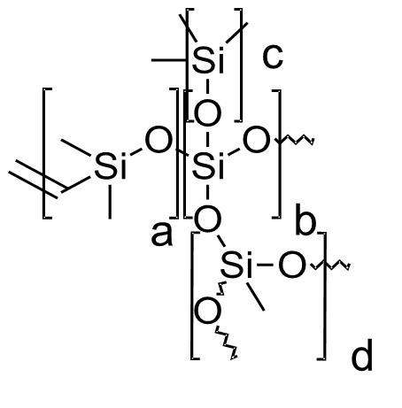
Impact of M(Vinyl)/Q
Component | M/Q=0.9 | M/Q=0.8 | M/Q=0.8 + 5 wt% 65K
SH 208-30Q | 18% | 18% | 16%
65K | 52% | 52% | 57%
VQT83-30 |  | 30% | 27%
VQ93T-30 | 30%
TPO-L | 0.5% | 0.5% | 0.6%
(a+c)/b
Notes:
Next, we examine the VTQ resin. This is the vinyl functional component that reacts with the mercapto groups. We look first at the M(V)/Q ratio. Two different VTQ samples VQ83T30 and VQ93T30 are evaluated in SH 208-30Q/VTQ/VIN system for rheological and mechanical properties. VQ83T30 has a M/Q ratio of 0.8:1 and VQ93T30 has a M/Q ratio of 0.9:1. In other words, more Q groups are present in VQ83T30. Both of these are evaluated at a SH/VINYL ratio of 3.63.
VQ83T30 has greater tear strength, hardness, storage modulus and cure rate than VQ93T30. The M/Q=0.8 material gives a more crosslinked and tougher resin than M/Q=0.9. However, it also gives less tensile strength, elongation, total energy under the area in comparison to VQ93T30. Similar to the results when changes were made to the MQT(SH) component, these formulations are improved by adding 5 wt% of 65K. This is expected when adding a chain extender.

Slide 23
SH 208-30Q | M/Q=0.9 | M/Q=0.8 | M/Q=0.8 + 5 wt% 65K
Property |  |  |  | Delta
SH/vinyl ratio | 3.63 | 3.63 | 3.62 | 0%
Tensile Strength (kPa) | 2898.85 | 2587.3 | 3186.03 | -23%
Elongation (%) | 130.64 | 85.5 | 148.51 | -74%
Total Energy (J/m) | 283.56 | 149.77 | 387.83 | -159%
Tear Strength (N/mm) | 3.92 | 4.32 | 4.63 | -7%
Shore A Hardness | 40 | 49 | 42 | 14%
G' (Pa) | 4.70E+05 | 5.97E+05 | 4.39E+05 | 26%
G" (Pa) | 3.66E+04 | 3.60E+04 | 2.82E+04 | 22%
tan delta | 0.078 | 0.06 | 0.064 | -7%
Cure rate (Pa/s) | 1.21E+05 | 1.73E+05 | 4.04E+04 | 77%
Appearance | very flexible, leaves no marks after twisting. |  | very flexible, maybe marks after twisting
M/Q=0.8 more crosslinked and tougher
less tensile strength, elongation, total energy
Notes:
Next, we examine the VTQ resin. This is the vinyl functional component that reacts with the mercapto groups. We look first at the M(V)/Q ratio. Two different VTQ samples VQ83T30 and VQ93T30 are evaluated in SH 208-30Q/VTQ/VIN system for rheological and mechanical properties. VQ83T30 has a M/Q ratio of 0.8:1 and VQ93T30 has a M/Q ratio of 0.9:1. In other words, more Q groups are present in VQ83T30. Both of these are evaluated at a SH/VINYL ratio of 3.63.
VQ83T30 has greater tear strength, hardness, storage modulus and cure rate than VQ93T30. The M/Q=0.8 material gives a more crosslinked and tougher resin than M/Q=0.9. However, it also gives less tensile strength, elongation, total energy under the area in comparison to VQ93T30. Similar to the results when changes were made to the MQT(SH) component, these formulations are improved by adding 5 wt% of 65K. This is expected when adding a chain extender.

Slide 24
Impact of Diluent Vinyl Content
Component | 0.060% vinyl | 0.078% vinyl
SH 208-30Q | 20.8% | 21.0%
65K (0.060% vinyl) | 42.6%
65K (0.078% vinyl) |  | 42.5%
VQT83-30/65K | 35.9% | 35.9%
TPO-L | 0.6% | 0.6%
x
Notes:
We next evaluated the vinyl content in the 65K for SH/VTQ/VIN system. We prepared to different 65K products. The difference between these two batches is vinyl contents of 0.060% and 0.078% vinyl respectively. These were evaluated using the SH 208-30Q and VQT83-30 resins.

Slide 25
SH 208-30Q | 0.060% vinyl | 0.078% vinyl
SH/vinyl ratio | 3.63 | 3.63
Tensile Strength (kPa) | 3571.56 | 4037.85
Elongation (%) | 73.71 | 84.8
Total Energy (J/m) | 209.13 | 238.75
Tear Strength (N/mm) | 3.46 | 5.11
Shore A Hardness | 59 | 57
G' (Pa) | 1.05E+06 | 1.09E+06
G" (Pa) | 7.46E+04 | 6.54E+04
tan delta | 0.071 | 0.06
Cure rate (Pa/s) | 1.83E+05 | 1.76E+05
Appearance | tears easily | very flexible, good twist
higher vinyl = better tensile strength, tear strength and twist

Slide 26
Vinyl in VQ Resin
c
a
b
Component | VQ91T30 0.63% Vinyl | VQ92T30 1.33% Vinyl | VQ93T30 1.88% Vinyl | VQ94T30 2.49% Vinyl
SH 208-20Q | 8.12% | 12.44% | 14.43% | 16.53%
65K | 25.87% | 39.67% | 46.07% | 49.09%
VQxT30 | 65.31% | 47.20% | 38.80% | 33.75%
TPO-L | 0.71% | 0.70% | 0.69% | 0.63%
SH/vinyl ratio | 2.35 | 2.34 | 2.34 | 2.33
d
a/c
Notes:
Vinyl content in VQ resin

Slide 27
Vinyl in VQ Resin
SH 208-20Q | VQ91T30 0.63% | VQ92T30 1.33% | VQ93T30 1.88% | VQ94T30 2.49%
SH/vinyl ratio | 2.35 | 2.34 | 2.34 | 2.33
Tensile Strength (kPa) | 1924.43 | 4923.25 | 3278.78 | not measured
Elongation (%) | 113.88 | 95.8 | 79.65
Total Energy (J/m) | 115.58 | 248.89 | 166.22
Tear Strength (N/mm) | 3.12 | 3.54 | 3.59
Shore A Hardness | 27 | 46 | 52
G' (Pa) | 1.63E+05 | 4.61E+05 | 7.53E+05 | 7.73E+05
G" (Pa) | 2.70E+04 | 4.67E+04 | 5.42E+04 | 4.47E+04
tan delta | 0.166 | 0.101 | 0.072 | 0.058
Cure rate (Pa/s) | 3.57E+04 | 8.04E+04 | 1.28E+05 | 2.79E+05
storage modulus, tear strength, hardness and cure rate increase whereas elongation decreases
Notes:
Vinyl content in VQ resin

Slide 28
More Diluent for Tear Strength
SH 208-20Q | VQ91T30 0.626% | VQ92T30 1.33% | VQ93T30 1.88% | VQ94T30 2.49%
SH/vinyl ratio | 2.35 | 2.34 | 2.34 | 2.29
Tensile Strength (kPa) | 1924.43 | 4923.25 | 3594.64 | 2861.09
Elongation (%) | 113.88 | 95.8 | 108.63 | 128.49
Total Energy (J/m) | 115.58 | 248.89 | 288.86 | 301.43
Tear Strength (N/mm) | 3.12 | 3.54 | 5.26 | 4.54
Shore A Hardness | 27 | 46 | 48 | 45
G' (Pa) | 1.63E+05 | 4.61E+05 | 4.83E+05 | 5.11E+05
G" (Pa) | 2.70E+04 | 4.67E+04 | 3.65E+04 | 3.00E+04
tan delta | 0.166 | 0.101 | 0.076 | 0.059
Cure rate (Pa/s) | 3.57E+04 | 8.04E+04 | 8.33E+04 | 2.30E+05
Appearance | soft | firm with okay tear | firm with good tear | firm with okay tear
Notes:
Adjusting stoichiometry and adding more 65K to max tear strength

Slide 29
Impact of T Groups
c
a
b
Component | VQ92T0 | VQ92T30 | VQ92T50 +5% xs 65K
SH 208-20Q | 10% | 12% | 12%
65K | 41% | 40% | 47%
VQ92Tx | 48% | 47% | 41%
TPO-L | 0.7% | 0.7% | 0.7%
d
d/b
Notes:
Effect of T groups

Slide 30
SH 208-20Q | VQ92T0 | VQ92T30 | VQ92T30 +5% xs 65K | VQ92T50 +5% xs 65K
SH/vinyl ratio | 2.32 | 2.34 | 2.32 | 2.33
Tensile Strength (kPa) | 5524.11 | 4923.25 | 4293.6 | 2816.47
Elongation (%) | 87 | 95.8 | 111.49 | 105.43
Total Energy (J/m) | 284.75 | 248.89 | 288.53 | 163.51
Tear Strength (N/mm) | 4.9 | 3.54 | 3.46 | 3.17
Shore A Hardness | 58 | 46 | 44 | 31
G' (Pa) | 9.14E+05 | 4.61E+05 | 4.25E+05 | 2.22E+05
G" (Pa) | 7.28E+04 | 4.67E+04 | 3.56E+04 | 1.68E+04
tan delta | 0.08 | 0.101 | 0.084 | 0.076
Cure rate (Pa/s) | 3.19E+05 | 8.04E+04 | 1.06E+05 | 5.27E+04
Appearance | Tough. Can be twisted. | Firm, can be twisted without break | Break after twisting | Soft, break upon twisting
T groups lowers mechanical and rheological properties
Notes:
Effect of T groups VTQ resin with zero T [d=0 Figure 2] groups gives the best rheological and mechanical properties. This is a tough material with excellent tear strength at 4.9 N/mm, fast cure rate and moderate hardness. The other samples also indicate that introducing T group to the VQ resin lowers both mechanical and rheological properties. This is likely again a steric hindrance effect.

Slide 31
Vinyl Content VQ Resins (T=0)
c
a
b
Component | VQ 92 1.07% vinyl | VQ 93 1.62% vinyl | VQ 94 2.15% vinyl
SH 208-30Q | 11% | 15% | 19%
65K | 55% | 52% | 50%
VQx | 34% | 32% | 31%
TPO-L | 0.8% | 0.8% | 0.8%
d
d=0
a/c
Notes:
Vinyl content in VQ resin (no T)

Slide 32
Vinyl Content VQ Resins (T=0)
SH 208-30Q | VQ 92 (1.07%) | VQ 93 (1.62%) | VQ94 (2.15%)
SH/vinyl ratio | 3.21 | 3.23 | 3.21
Tensile Strength (kPa) | 3957.38 | 1642.08 | 2907.32
Elongation (%) | 156.51 | 65.09 | 75.2
Total Energy (J/m) | 550.25 | 79.41 | 185.8
Tear Strength (N/mm) | 6.95 | 3.8 | 4.84
Shore A Hardness | 44 | 50 | 56
G' (Pa) | 4.71E+05 | 7.20E+05 | 1.26E+06
G" (Pa) | 3.47E+04 | 4.35E+04 | 6.90E+04
tan delta | 0.074 | 0.06 | 0.055
Cure rate (Pa/s) | 1.21E+05 | 1.70E+05 | 1.84E+05
Appearance | Very tough flexible, white opaque | breaks upon twisting
Notes:
Vinyl content in VQ resin (no T)

Slide 33
3D Printing
Component | YL2-153A | YL2-153B | YL4-10A
Proprietary MQT(SH) | 21.5% | 15.1% | 15.6%
65K | 42.3% | 45.8% | 51.7%
VQT83-30 | 35.6% | 38.6% | 0
VQ92 | 0 | 0 | 32.0%
TPO-L | 0.6% | 0.6% | 0.7%
SH/vinyl | 3.63 | 3.63 | 4.88
Tensile Strength (kPa) | 3,495.98 | 2,303.68 | 4027.13
Elongation (%) | 99.07 | 55.87 | 202.96
Total Energy (J/m) | 262.95 | 104.34 | 762.75
Tear Strength (N/mm) | 6.81 | 5.33 | 8.19
Shore A Hardness | 55.00 | 53.00 | 46
G' (Pa) | 6.41E+05 | 1.20E+06 | 4.73E+05
G" (Pa) | 1.14E+05 | 5.23E+04 | 5.26E+04
tan delta | 0.18 | 0.04 | 0.1112
Cure rate (Pa/s) | 8.65E+04 | 2.87E+05 | 7.62E+04
Notes:
IDK yet

Slide 34
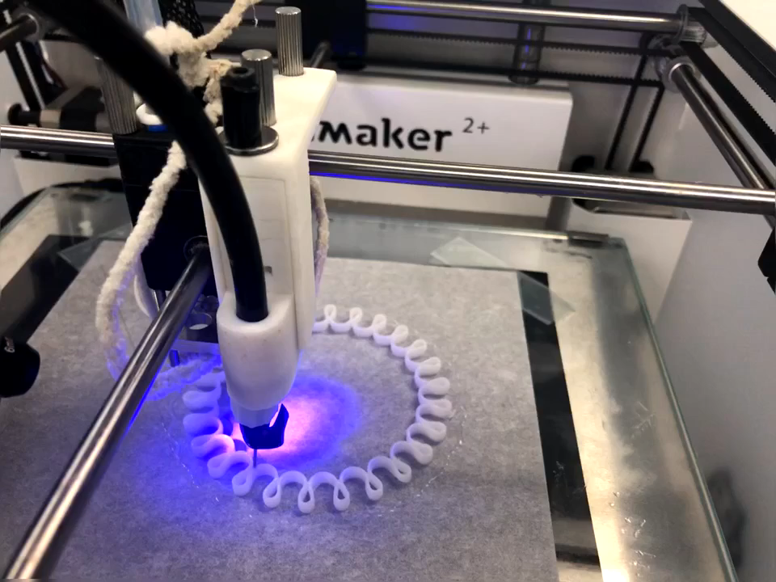

Slide 35
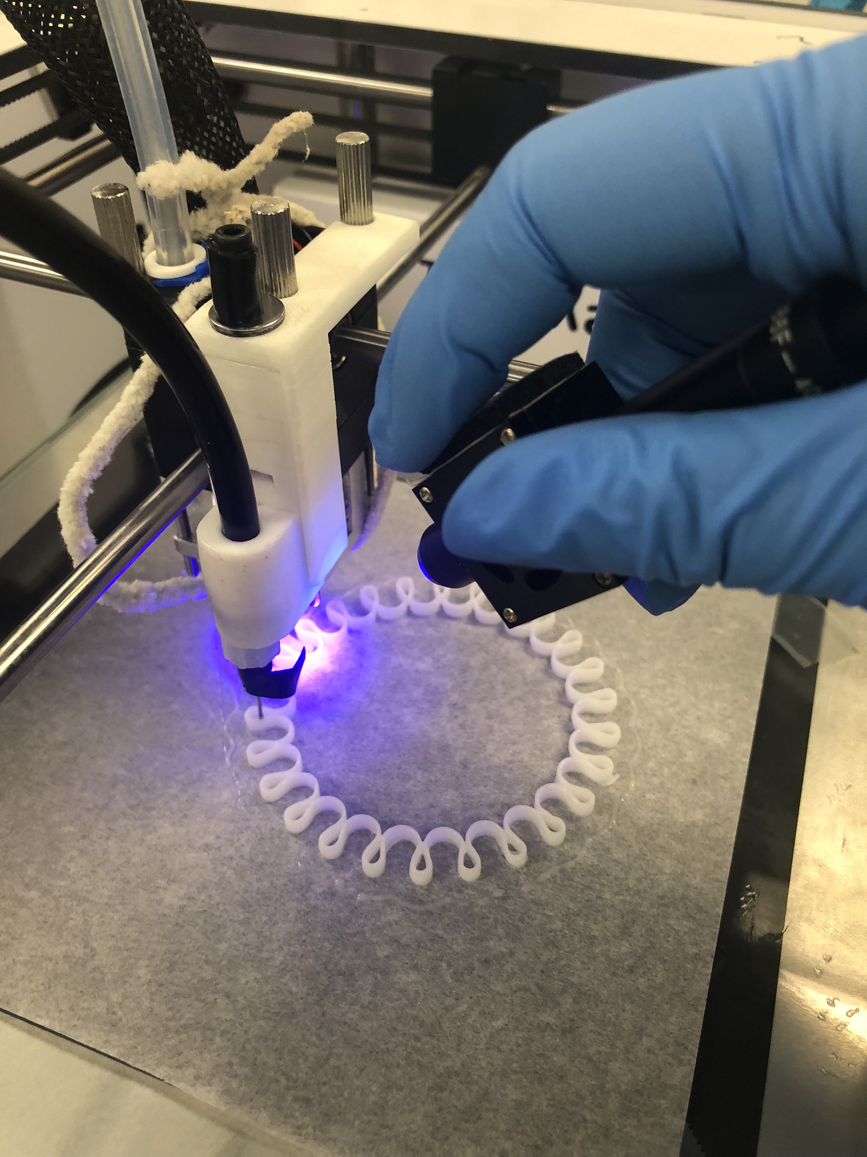
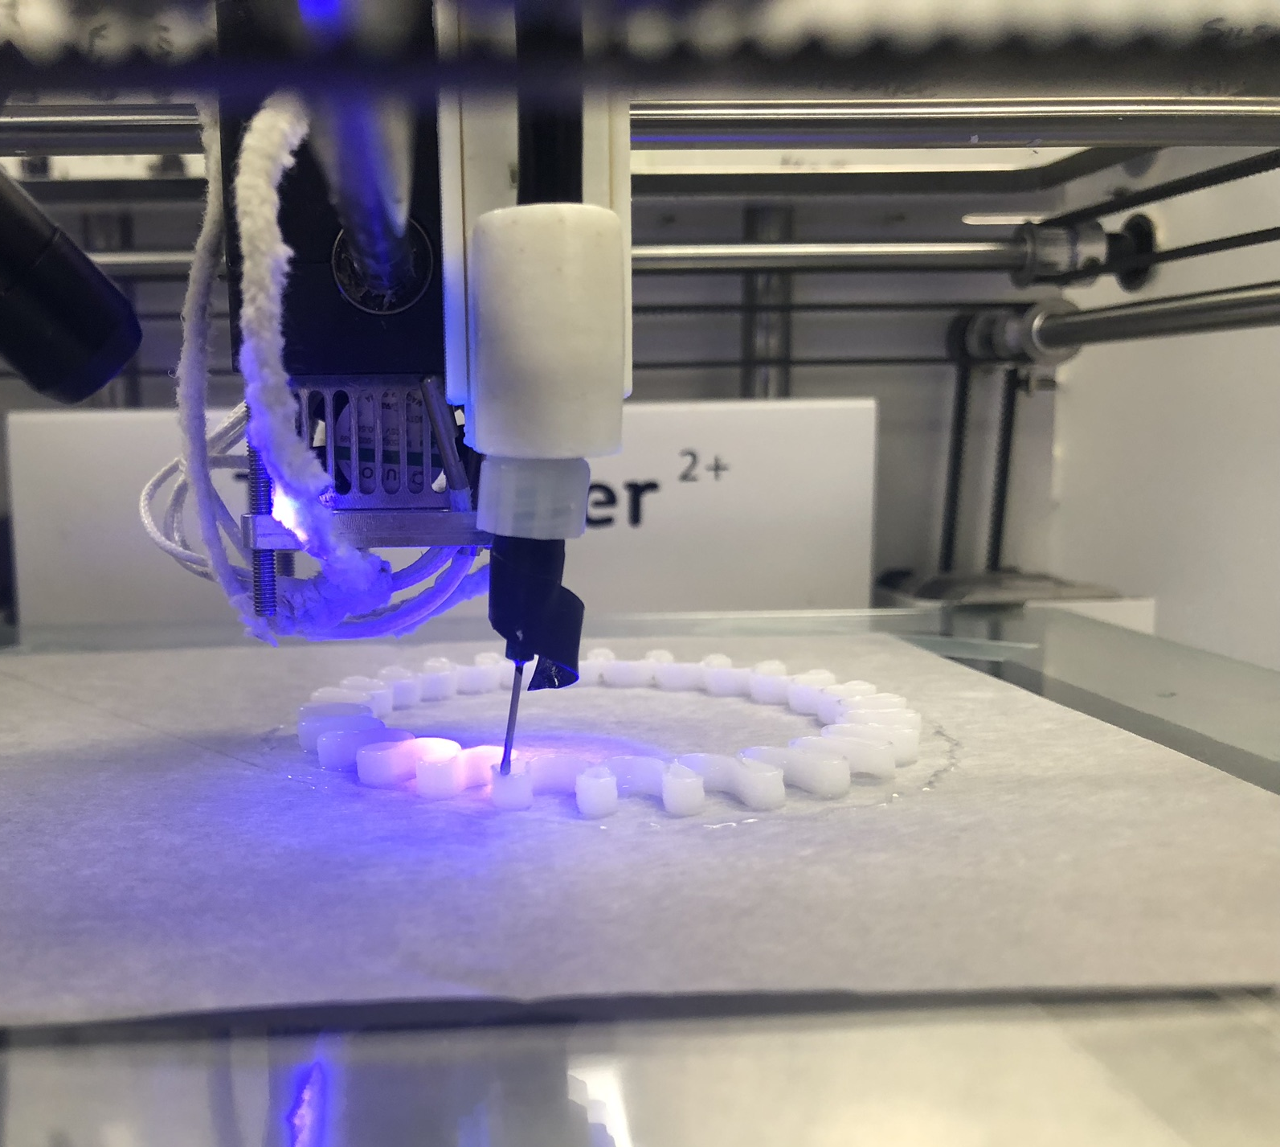
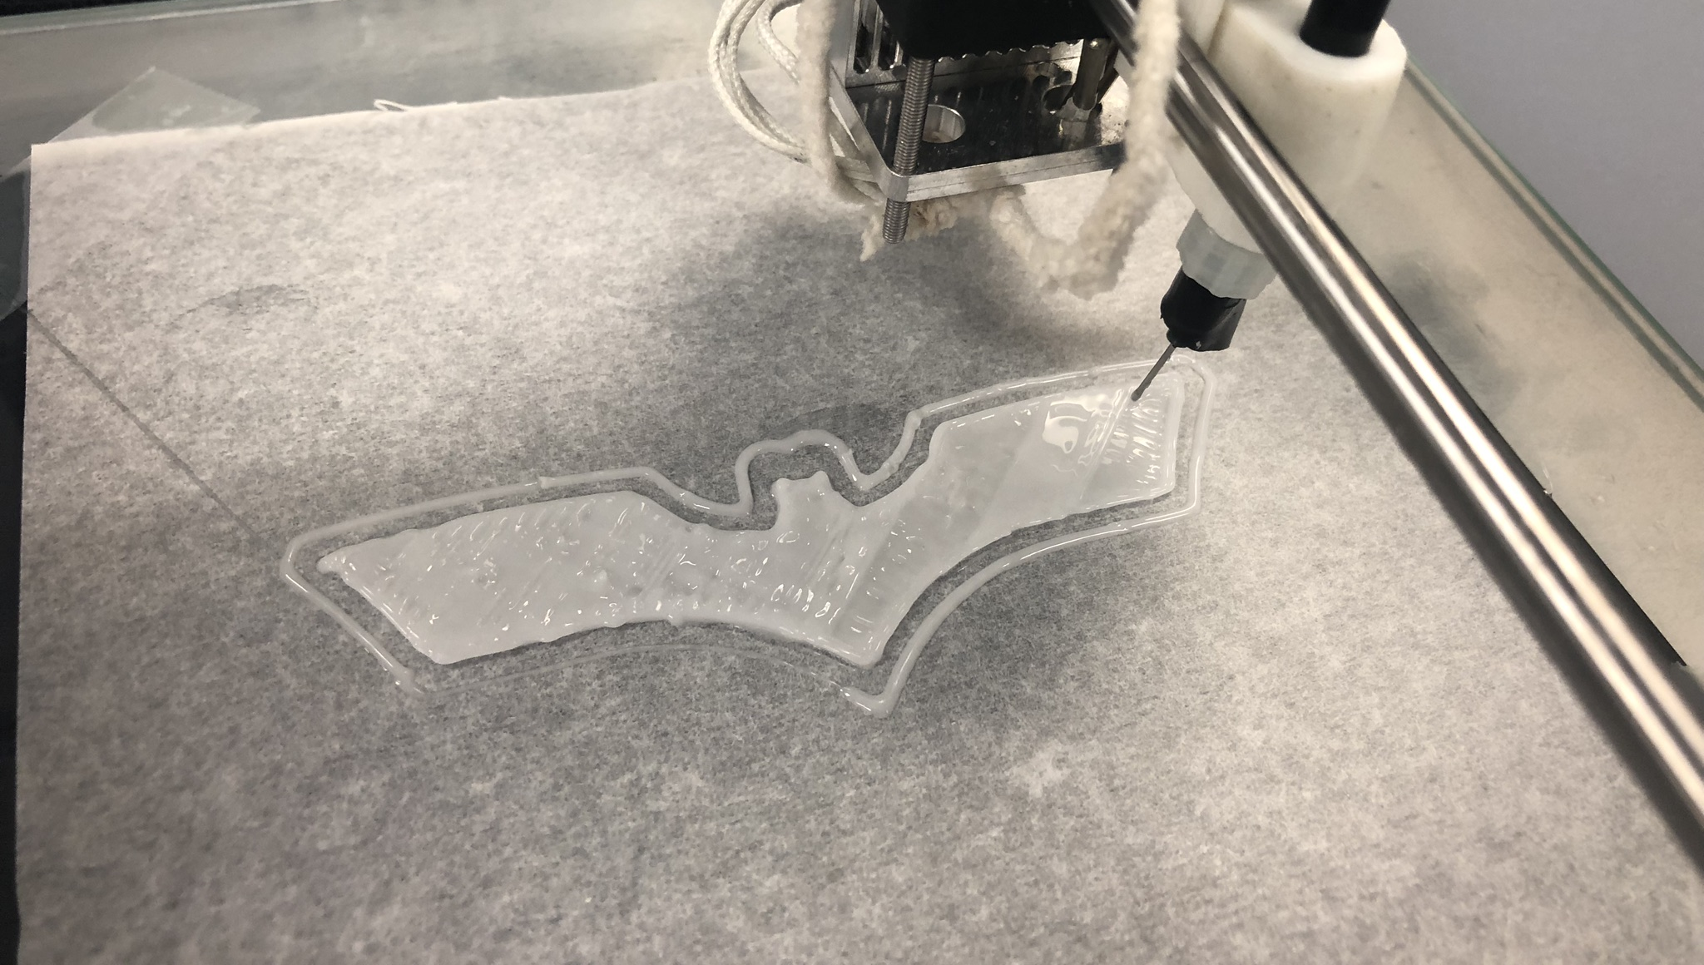

Slide 36
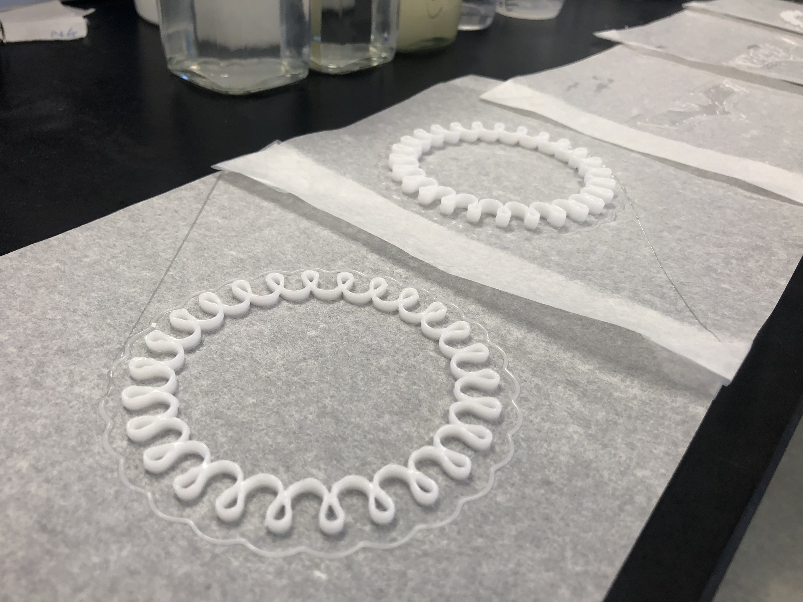

Slide 37
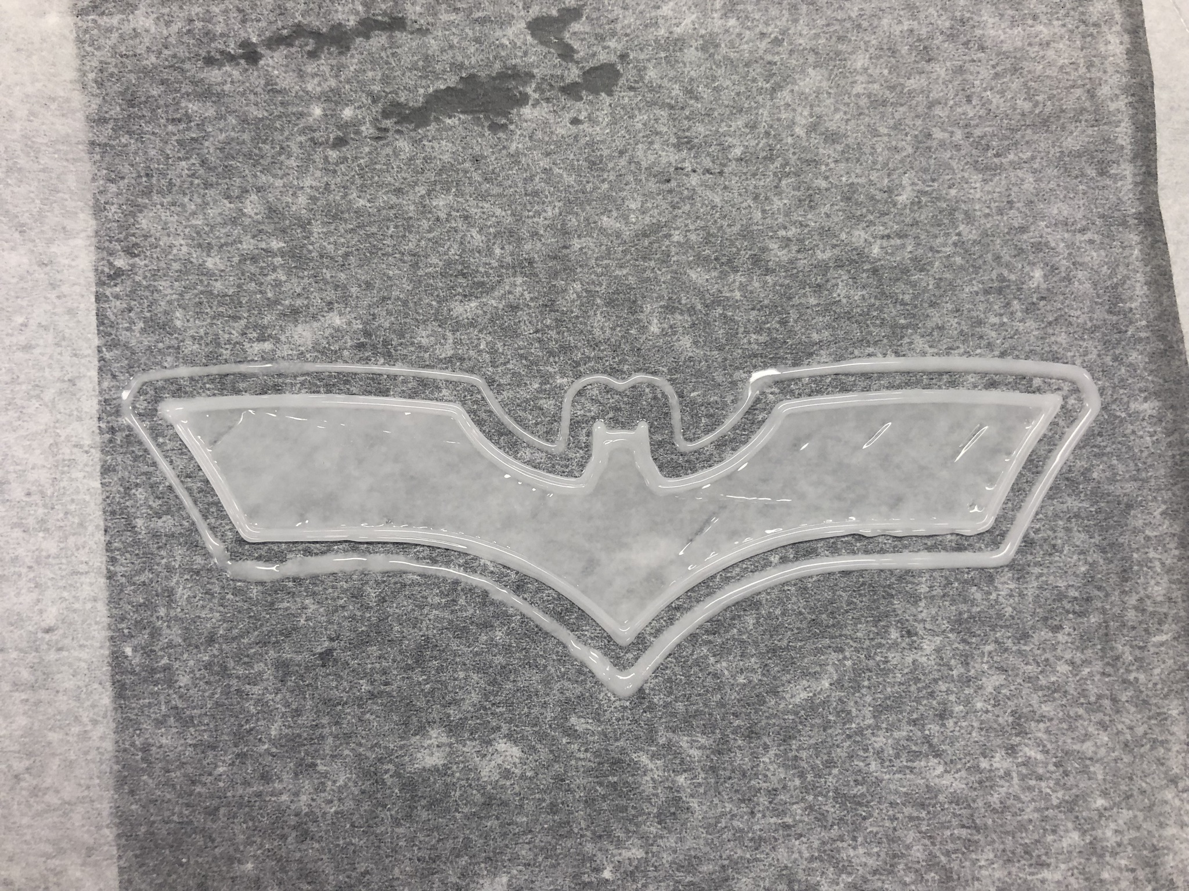

Slide 38
Conclusions
MQT(SH) resin: more than -30Q unusable. T groups lower viscosity, but hardness and toughness suffer quickly.
VTQ resin: M/Q ratios of 0.8 are best.
SH/vinyl: is critical. Up to 17% VQ resin is ok.
65K: gives elongation and tear strength but a large reduction of hardness and tensile strength. 5% or less excess.
Increasing the vinyl content of 65K improved tensile strength, tear strength and flexibility.

Slide 39
Conclusions
We developed formulations which were:
  up to 200% elongation
  Shore A hardness of 59
  Tear Strength of 8
Further optimization of this work into a commercial product will be guided by the conclusions on this report and customer’s needs.

Slide 40

Thank
You

